Slide 1
Intro to Networking
CSE 405 January 2025 - Lecture 4
Special Thanks to Peyrin Kao (UC Berkeley)

Slide 2
Today: Intro to Networking
Internet: A global network of computers
OSI model: A layered model of protocols
Notes:
No attacks,
High level
Next couple lectures digging into specific parts of the networking protocols

Slide 3
What’s the Internet?
Textbook Chapter 25

Slide 4
What’s the Internet?
Network: A set of connected machines that can communicate with each other
Machines on the network agree on a protocol, a set of rules for communication
Internet: A global network of computers
The web sends data between browsers and servers using the Internet
The Internet can be used for more than the web (e.g., SSH)
Notes:
1 slide info
Already seen
Browser and server send info, how does that happen?
Thats the internet
How do they talk to each other?
Web is Data thats being sent between browsers and servers
Internet is how that data is actually sent
Connections, protocols
Network of networks

Slide 5
Protocols
A protocol is an agreement on how to communicate that specifies syntax and semantics
Syntax: How a communication is specified and structured (format, order of messages)
Semantics: What a communication means (actions taken when sending/receiving messages)
Example: Protocol for asking a question in lecture?
The student should raise their hand
The student should wait to be called on by the speaker or wait for the speaker to pause
The student should speak the question after being called on or after waiting
If the student has been unrecognized after some time: Vocalize with “Excuse me!”

Slide 6
Internet Analogy: Mail

Slide 7
What’s the goal of the Internet?
Move data from one location to another
Analogy: I write a message on a piece of paper. How do I send this message to you?
Solution: Postal system

Slide 8
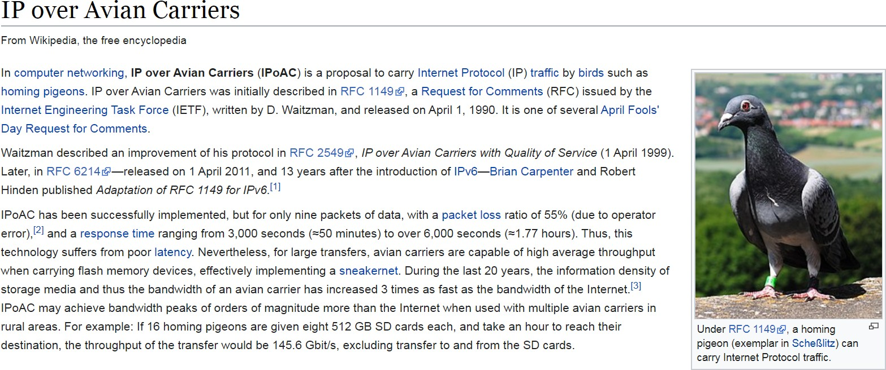
Building block 1: Something That Moves Data
Mailman, Pony Express, carrier pigeon, etc.
Are pigeons faster than the Internet?

Slide 9


Building block 1: Something That Moves Data
The Internet is built on technology that moves bits across space
Voltages on wires, wireless technology, radio waves, etc.
An example of packet loss.
Notes:
Instead of pigeons, electrical way to connect computers
Wires
Wireless tech
Radiowaves
Building block that moves data from point a to b
Not talk in detail
Pick one

Slide 10

Building block 2: Talking to the Apartment Complex
Using building block 1, we can link up people within a local apartment complex
Forms a local area network (LAN)
Building block 1: wires
Building block 2: local network
Notes:
Waht do we do with building block
Hook up 2 computers
Take every computer and connect with wires like building block
But messy wires get lost,e tc
Instead im going to use my building blocks and build them up
Chose wires, could have chosen wireless
Instead of one really long wire, take everyone within one local scope and connect all of those up
for example all comps in berkeley network and connect them all up
If do that you get a Local area network
In mail – carrier pigeon cant fly to everywher ein the world, but it can connect to everyone within the apartment complex
Gonna use that to extend to the rest of the world

Slide 11



Building block 3: Post offices
A post office connects two or more apartment complexes
Forms a wide area network
Building block 1: wires Building block 2: local network
Building block 3: wide area network
Notes:
Our goal is to connect the entire world
Connect 2 apartment complexes
Could draw all crosswires between them, but thats a mess
Connect witha single wire through a post office
Wide area network, 2 diff local area networks witha router

Slide 12
Building block 3: The Internet
Connect the entire world using post offices
Messages may pass through multiple post offices before reaching destination
Building block 1: wires
Building block 2: local network
Building block 3: the Internet
Notes:
Goal: with enough post offices and enough of little local networks, can build up a huge network of networks
Network of networks: red square, and then green square connected by post offices

Slide 13
Building block 3: The Internet
Connect the entire world using post offices
Messages may pass through multiple post offices before reaching destination
Building block 1: wires
Building block 2: local network
Building block 3: the Internet
Notes:
How to get letter from me in top left to friend in bottom right
Hop through multiple post offices
Not direct line

Slide 14
Layers of abstraction
Layer 3: Connect many local networks to form a global network
Layer 2: Create links in a local area
Layer 1: Move bits across space
A change in layer 1 implementation (wireless instead of wires) doesn’t affect the other layers
A change in layer 2 protocols doesn’t affect the other layers
Notes:
Havent told you how these layers are implemented yet, but layers of abstraction
Dont need to understand how they work to use them
Building blocks
Dont need to worry about layers below or above it
If someone changes layer 1 it doesnt matter because were on a diff layer dont affect layers of abstraction
Pigeons? Radio waves?

Slide 15
Layering: The OSI Model

Slide 16

Layering
Internet design is partitioned into various layers. Each layer…
Has a protocol
Relies on services provided by the layer below it
Provides services to the layer above it
Analogous to the structure of an application and the “services” that each layer relies on and provides
Code You Write
Run-Time Library
System Calls
Device Drivers
Fully isolated from user programs
Voltage Levels/Magnetic Domains
Notes:
Analogy of computer layer of abstraction
Walk through layers on the right hand side

Slide 17

OSI Model
OSI model: Open Systems Interconnection model, a layered model of Internet communication
Originally divided into 7 layers
But layers 5 and 6 aren’t used in the real world, so we ignore them
Same reliance upon abstraction
A layer can be implemented in different ways without affecting other layers
A layer’s protocol can be substituted with another protocol without affecting other layers
7
Application
4
Transport
3
(Inter) Network
2
Link
1
Physical
Notes:
1970s model
Some things are obsolete
In real life the boundaries blur, but a good starting point
In web not every website is build the same way, same here

Slide 18
Layer 1: Physical Layer
Provides: Sending bits from one device to another
Encodes bits to send them over a physical link
Patterns of voltage levels
Photon intensities
RF modulation
Examples
Wi-Fi radios (IEEE 802.11)
Ethernet voltages (IEEE 802.3)
7
Application
4
Transport
3
(Inter) Network
2
Link
1
Physical
Notes:
Start at bottom
Each layer, what does this layer provide as a service to higher layers
What does this layer rely on
Apartment complex: already trained the pigeons
Just have to provide an interface that someone else can use
Physical layer
Engineering stuff for data to go from point a to point b
Anyone above us can assume that this is done

Slide 19
Layer 1: Physical Layer
Physical layer: “How do I transmit this sequence of 0’s and 1’s from A to B?”
7
Application
4
Transport
A
01110111…01
B
3
(Inter) Network
2
Link
1
Physical
Next: How do we talk to more than one device?

Slide 20
Layer 2: Link Layer
Provides: Sending frames directly from one device to another
Relies upon: Sending bits from one device to another
Encodes messages into groups of bits called “frames”
Examples
Ethernet frames (IEEE 802.3)
7
Application
4
Transport
3
(Inter) Network
2
Link
1
Physical
Notes:
Service for everyone above me
Connect up all devices in a local network
Anybody above can assume taht local network exists

Slide 21
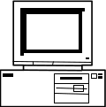
Layer 2: Link Layer
Local area network (LAN): A set of computers on a shared network that can directly address one another
Consists of multiple physical links
Frames must consist of at least 3 things:
Source (“Who is this message coming from?”)
Destination (“Who is this message going to?”)
Data (“What does this message say?”)
Source: A
Destination: C
“Hello, this is A…”
A
B
C
D
Notes:
Now start sending messages and start thinking of protocols that start sending messages
Sometimes these are called frames

Slide 22
Layer 2: Link Layer
In reality, computers aren’t all connected to the same wire
Instead, local networks are a set of point-to-point links
However, Layer 2 still allows direct addressing between any two devices on the local-area network
Enabled by transmitting a frame across multiple physical links until it reaches its destination
Source: A
Dest: C
“Hello, this is A…”
B
A
E
D
C
Notes:
Even tho that was the picture that we will take with use and we can assume that computers ar connected, that doesnt necessarily have to be true
Can have computers connected in a graph
All done in layer 2, so anyone in anothe rlayer can assume it looks like prev slide

Slide 23
Ethernet and MAC Addresses
Ethernet: A common layer 2 protocol that most endpoint devices use
MAC address: A 6-byte address that identifies a piece of network equipment (e.g., your phone’s Wi-Fi antenna)
Typically represented as 6 hex bytes: 13:37:ca:fe:f0:0d
The first 3 bytes are assigned to manufacturers (i.e. who made the equipment)
This is useful in identifying a device
The last 3 bytes are device-specific
Notes:
Irl prob not labeled nicely abcd
Instead what are protocols in layer 2 and how do they identify computers
so a really common protocol at layer 2 is ethernet, wired connection
MACs are not the same
MAC address have nothing to do with cryptographic macs
Hardware address baked in, unique address

Slide 24
Layer 2: Link Layer
Link layer: “How do I transmit this frame from A to C, making sure that no one else thinks the message is for them?”
7
Application
Source: A
Dest: C
“Hello, this is A…”
4
Transport
3
(Inter) Network
A
B
C
D
2
Link
1
Physical
Next: How do we address every device in existence?

Slide 25
Layer 3: Network Layer
Provides: Sending packets from any device to any other device
Relies upon: Sending frames directly from one device to another
Encodes messages into groups of bits called “packets”
Bridges multiple LANs to provide global addressing
Examples
Internet Protocol (IP)
7
Application
4
Transport
3
(Inter) Network
2
Link
1
Physical
Notes:
Global network is network layer
Doesnt worry about how data is sent or how local networks are hooked up
Connect local networks together

Slide 26
Layer 3: Network Layer
Recall the ideal layer 2 model: All devices can directly address all other devices
This would not scale to the size of the Internet!
Instead, allow packets to be routed across different devices to reach the destination
Each hop is allowed to use its own physical and link layers!
A
B
C
D
Router
E
F
G
H
Notes:
Dont need to crosswire very pair together
Layers of abstraction, how abcd are connected i dont care about

Slide 27
Layer 3: Network Layer
C
Source: A
Destination: D
“Hello, this is A…”
A
D
Router
Router
Router
Router
Router
E
B
Router
Router
Notes:
Send to multiple routers
Packet, layer 3 term for message

Slide 28
Layer 3: Network Layer
This link could be Wi-Fi
C
Source: A
Destination: D
“Hello, this is A…”
And this link could be Ethernet
A
D
Router
Router
Router
But the Internet protocol stays the same, end to end
Router
Router
E
B
Router
Router

Slide 29
Layer 3: Network Layer
Packets must consist of at least 3 things:
Source (“Who is this message coming from?”)
Destination (“Who is this message going to?”)
Data (“What does this message say?”)
Similar to frames (layer 2)
Packets may be fragmented into smaller packets
Different links might support different maximum packet sizes
Up to the recipient to reassemble fragments into the original packet
Each router forwards a given packet to the next hop
We will cover how a router knows how to forward—and attacks on it—in the future
Packets are not guaranteed to take a given route
Two packets with the same source and destination may take different routes
Notes:
Smaller packets: Will talk about later, in TCP
Ask: Why take different routes? What might happen?

Slide 30
Internet Protocol (IP)
Internet Protocol (IP): The universal layer-3 protocol that all devices use to transmit data over the Internet
IP address: An address that identifies a device on the Internet
IPv4 is 32 bits, typically written as 4 decimal octets, e.g. 35.163.72.93
IPv6 is 128 bits, typically written as 8 groups of 2 hex bytes: 2607:f140:8801::1:23
If digits or groups are missing, fill with 0’s, so 2607:f140:8801:0000:0000:0000:0001:0023
Globally unique from any single perspective
For now, you can think of them as just being globally unique
IP addresses help nodes make decisions on where to forward the packet
Notes:
At layer 2 we used MAC address
Ran out of ipv4 so started ipv6
Globally unique: network address translation that allows multiple computers to have a single ip address from the perspective of the outside world, not something well talk about in detail
For now, ip addresses are globally unique – good enough for us, but not technically true
Why are there 2 addressing systems? Because the the ip address has useful info about where this computer is like in berkeley, china, antarctica
Maybe the mac address, the hardware address, doesnt
Has the manufacturer that th eip address doesnt
Need both addresses

Slide 31
Reliability
Reliability ensures that packets are received correctly or, if random errors occur, not at all
This is implemented with a checksum
However, there is no cryptographic MAC, so there are no guarantees if an attacker modifies packets
IP is unreliable and only provides a best effort delivery service, which means:
Packets may be lost (“dropped”)
Packets may be corrupted
Packets may be delivered out of order
It is up to higher level protocols to ensure that the connection is reliable
Notes:
Problem, not fix today
If im sending a letter: letter is correct and there are no random errors and the letter in 2 parts is in order

Slide 32
Layer 3: Network Layer
Layer 3: “How do I get this packet from A to D?”
C
Source: A
Destination: D
“Hello, this is A…”
Next: How do we reliably send any length of data, not just packets?
A
D
Router
Router
Router
Router
Router
E
B
Router
Router

Slide 33
Layer 4: Transport Layer
Provides: Transportation of variable-length data from any point to any other point
Relies upon: Sending packets from any device to any other device
Builds abstractions that are useful to applications on top of layer 3 packets
Useful abstractions
Reliability: Transmit data reliably, in order
Ports: Provide multiple “addresses” per real IP address
Examples
TCP: Provides reliability and ports
UDP: Provides ports, but no reliability
7
Application
4
Transport
3
(Inter) Network
2
Link
1
Physical
Notes:
TCP a couple lectures from now
Provide reliability
If fails, resend,
If out of order will add time stamps or something
Stay tuned

Slide 34
Layer 4: Transport Layer
I am now sending an arbitrary length message that will probably be broken into several packets…
Unreliable Internet
A
D
Layer 4: “How do I transport this arbitrary data over an unreliable medium?”
Notes:
Who cares how internet was implemented
Layers of abstraction

Slide 35
Layer 7: Application Layer
Provides: Applications and services to users
Relies upon: Transportation of variable-length data from any point to any other point
Every online application is Layer 7
Web browsing
Online video games
Messaging services
Video calls (Zoom)
7
Application
4
Transport
3
(Inter) Network
2
Link
1
Physical
Notes:
So far weve been talking about arbitrary data - 1s and 0s
But at layer 7 can build rich application like social media websites, etc
Simplification model

Slide 36
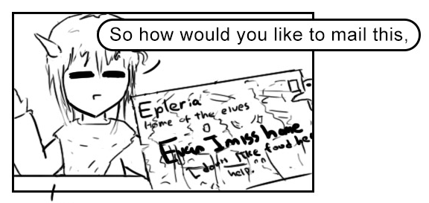
Headers

Slide 37


Example: Sending Mail
Alice
Bob
I am hungry.

Slide 38

Example: Sending Mail
Alice
Bob
Send to: Bob
I am hungry.

Slide 39
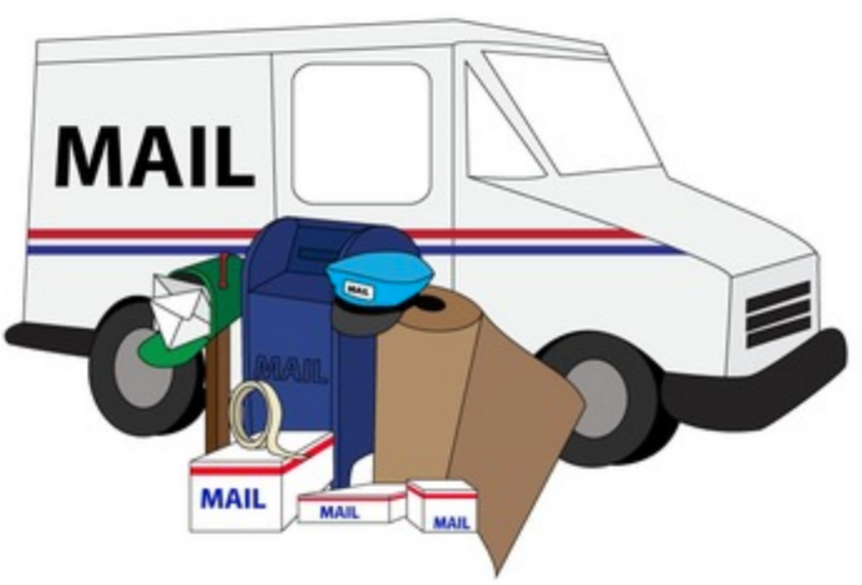
Example: Sending Mail
Alice
Bob
Mail to: 123 Bob St
Send to: Bob
I am hungry.

Slide 40
Example: Sending Mail
Alice
Bob
Mail to: 123 Bob St
Send to: Bob
I am hungry.
Notes:
Because its already made its way to bobs address this top header/address/letter doesnt matter anymore so i can just take that envelope and throw it away

Slide 41
Example: Sending Mail
Alice
Bob
Send to: Bob
I am hungry.

Slide 42
Example: Sending Mail
Alice
Bob
I am hungry.
Notes:
Go back through again, Emphasize abstraction and wrapping and unwrapping of headers

Slide 43
Example: Sending Mail
Each layer communicates with each other, relying on abstractions below them!
Alice
Bob
Relies upon: Sending messages to people
Provides: Sending messages to people
Relies upon: Sending messages to addresses
Provides: Sending messages to addresses

Slide 44
Layers of Abstraction and Headers
As you move to lower layers, we wrap additional headers around the message
As you move to higher layers, you peel off headers around the message
Mail to: 123 Bob St
Send to: Bob
Send to: Bob
I’m hungry.
I’m hungry.
I’m hungry.
Higher layer, fewer headers
Lower layer, more headers

Slide 45
Layers of Abstraction and Headers
As you move to lower layers, you wrap additional headers around the message
As you move to higher layers, you peel off headers around the message
When sending a message we go from the highest to the lowest layer
When receiving a message we go from the lowest to highest layer

Slide 46
Layer 2 Header
Source MAC Address (6 bytes)
Destination MAC Address (6 bytes)
VLAN Tag (4 bytes) |  |  |  | Type (2 bytes)
Data (variable-length)
Ethernet and MAC address headers

Slide 47
Layer 3 Header
Version (4 bits) |  | Header Length (4 bits) |  | Type of Service (6 bits) |  |  | ECN (2 bits) | Total Length (16 bits)
Identification (16 bits) |  |  |  |  |  |  |  | Flags (3 bits) |  | Fragment Offset (13 bits)
Time to Live (8 bits) |  |  |  | Protocol (8 bits) |  |  |  | Header Checksum (16 bits)
Source Address (32 bits)
Destination Address (32 bits)
Options (variable length)
Data (variable length)
IPv4 header
Notes:
Notice: Source address, destination address, header checksum, fragment offset, and data

Slide 48
Example: HTTP Request
HTTP
GET / HTTP/1.1
...
HTTP
TCP
TCP
IP
IP
Ethernet
Ethernet
Wires
Wires

Slide 49
Example: HTTP Request
HTTP
HTTP
From: Port 1234
To: Port 80
TCP
GET / HTTP/1.1
...
TCP
IP
IP
Ethernet
Ethernet
Wires
Wires

Slide 50
Example: HTTP Request
HTTP
HTTP
Final destination
From: 1.2.3.4
To: 5.6.7.8
TCP
TCP
From: Port 1234
To: Port 80
IP
GET / HTTP/1.1
...
IP
Ethernet
Ethernet
Wires
Wires

Slide 51
Example: HTTP Request
HTTP
HTTP
Address of next hop
TCP
From: 20:61:84:3a:a9:52
To: 6d:36:ff:4a:32:92
TCP
From: 1.2.3.4
To: 5.6.7.8
IP
IP
From: Port 1234
To: Port 80
Ethernet
GET / HTTP/1.1
...
Ethernet
Wires
Wires

Slide 52
Example: HTTP Request
HTTP
HTTP
TCP
TCP
Converted into bits and transmitted
IP
From: 20:61:84:3a:a9:52
To: 6d:36:ff:4a:32:92
IP
From: 1.2.3.4
To: 5.6.7.8
Ethernet
Ethernet
From: Port 1234
To: Port 80
GET / HTTP/1.1
...
Wires
Wires

Slide 53
Example: HTTP Request
HTTP
HTTP
TCP
TCP
Received over the physical medium
IP
From: 89:8d:33:25:47:24
To: d5:a9:20:68:e0:80
IP
Notice: The MAC addresses changed because the recipient is on a different network
From: 1.2.3.4
To: 5.6.7.8
Ethernet
Ethernet
From: Port 1234
To: Port 80
GET / HTTP/1.1
...
Wires
Wires

Slide 54
Example: HTTP Request
HTTP
HTTP
TCP
TCP
From: 89:8d:33:25:47:24
To: d5:a9:20:68:e0:80
From: 1.2.3.4
To: 5.6.7.8
IP
IP
From: Port 1234
To: Port 80
Ethernet
GET / HTTP/1.1
...
Ethernet
Wires
Wires

Slide 55
Example: HTTP Request
HTTP
HTTP
From: 1.2.3.4
To: 5.6.7.8
TCP
TCP
From: Port 1234
To: Port 80
IP
GET / HTTP/1.1
...
IP
Ethernet
Ethernet
Wires
Wires

Slide 56
Example: HTTP Request
HTTP
HTTP
From: Port 1234
To: Port 80
TCP
GET / HTTP/1.1
...
TCP
IP
IP
Ethernet
Ethernet
Wires
Wires

Slide 57
Example: HTTP Request
HTTP
GET / HTTP/1.1
...
HTTP
TCP
TCP
IP
IP
Ethernet
Ethernet
Wires
Wires

Slide 58
Example: HTTP Request
Relies upon: Transport of data
HTTP
HTTP
Provides: Transport of data
Relies upon: Global packet delivery
TCP
TCP
Provides: Global packet delivery
Relies upon: Local frame delivery
IP
IP
Provides: Local frame delivery
Relies upon: Communication of bits
Ethernet
Ethernet
Provides: Communication of bits
Wires
Wires

Slide 59
Intro to Networking: Summary
Internet: A global network of computers
Protocols: Agreed-upon systems of communication
OSI model: A layered model of protocols
Layer 1: Communication of bits
Layer 2: Local frame delivery
Ethernet: The most common Layer 2 protocol
MAC addresses: 6-byte addressing system used by Ethernet
Layer 3: Global packet delivery
IP: The universal Layer 3 protocol
IP addresses: 4-byte (or 16-byte) addressing system used by IP
Layer 4: Transport of data (more on this next time)
Layer 7: Applications and services (the web)
7
Application
4
Transport
3
(Inter) Network
2
Link
1
Physical

